Slide 1

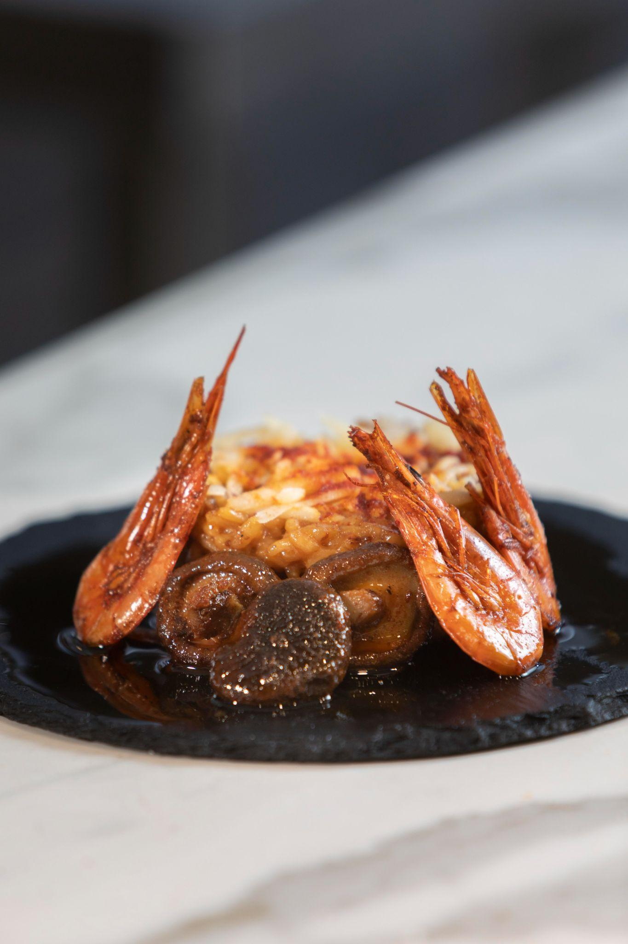

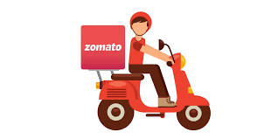
SINCE 1980
ZOMATO INDIA
Never have a bad meal :)

Slide 2
TEAM MEMBERS
NAME | ROLL NO
ADHYA SINGH | 40821006
SUMIT PRAJAPATI | 40821111
TANISHA PANCHAL | 4821113
UMESH NAWAN | 40821119

Slide 3
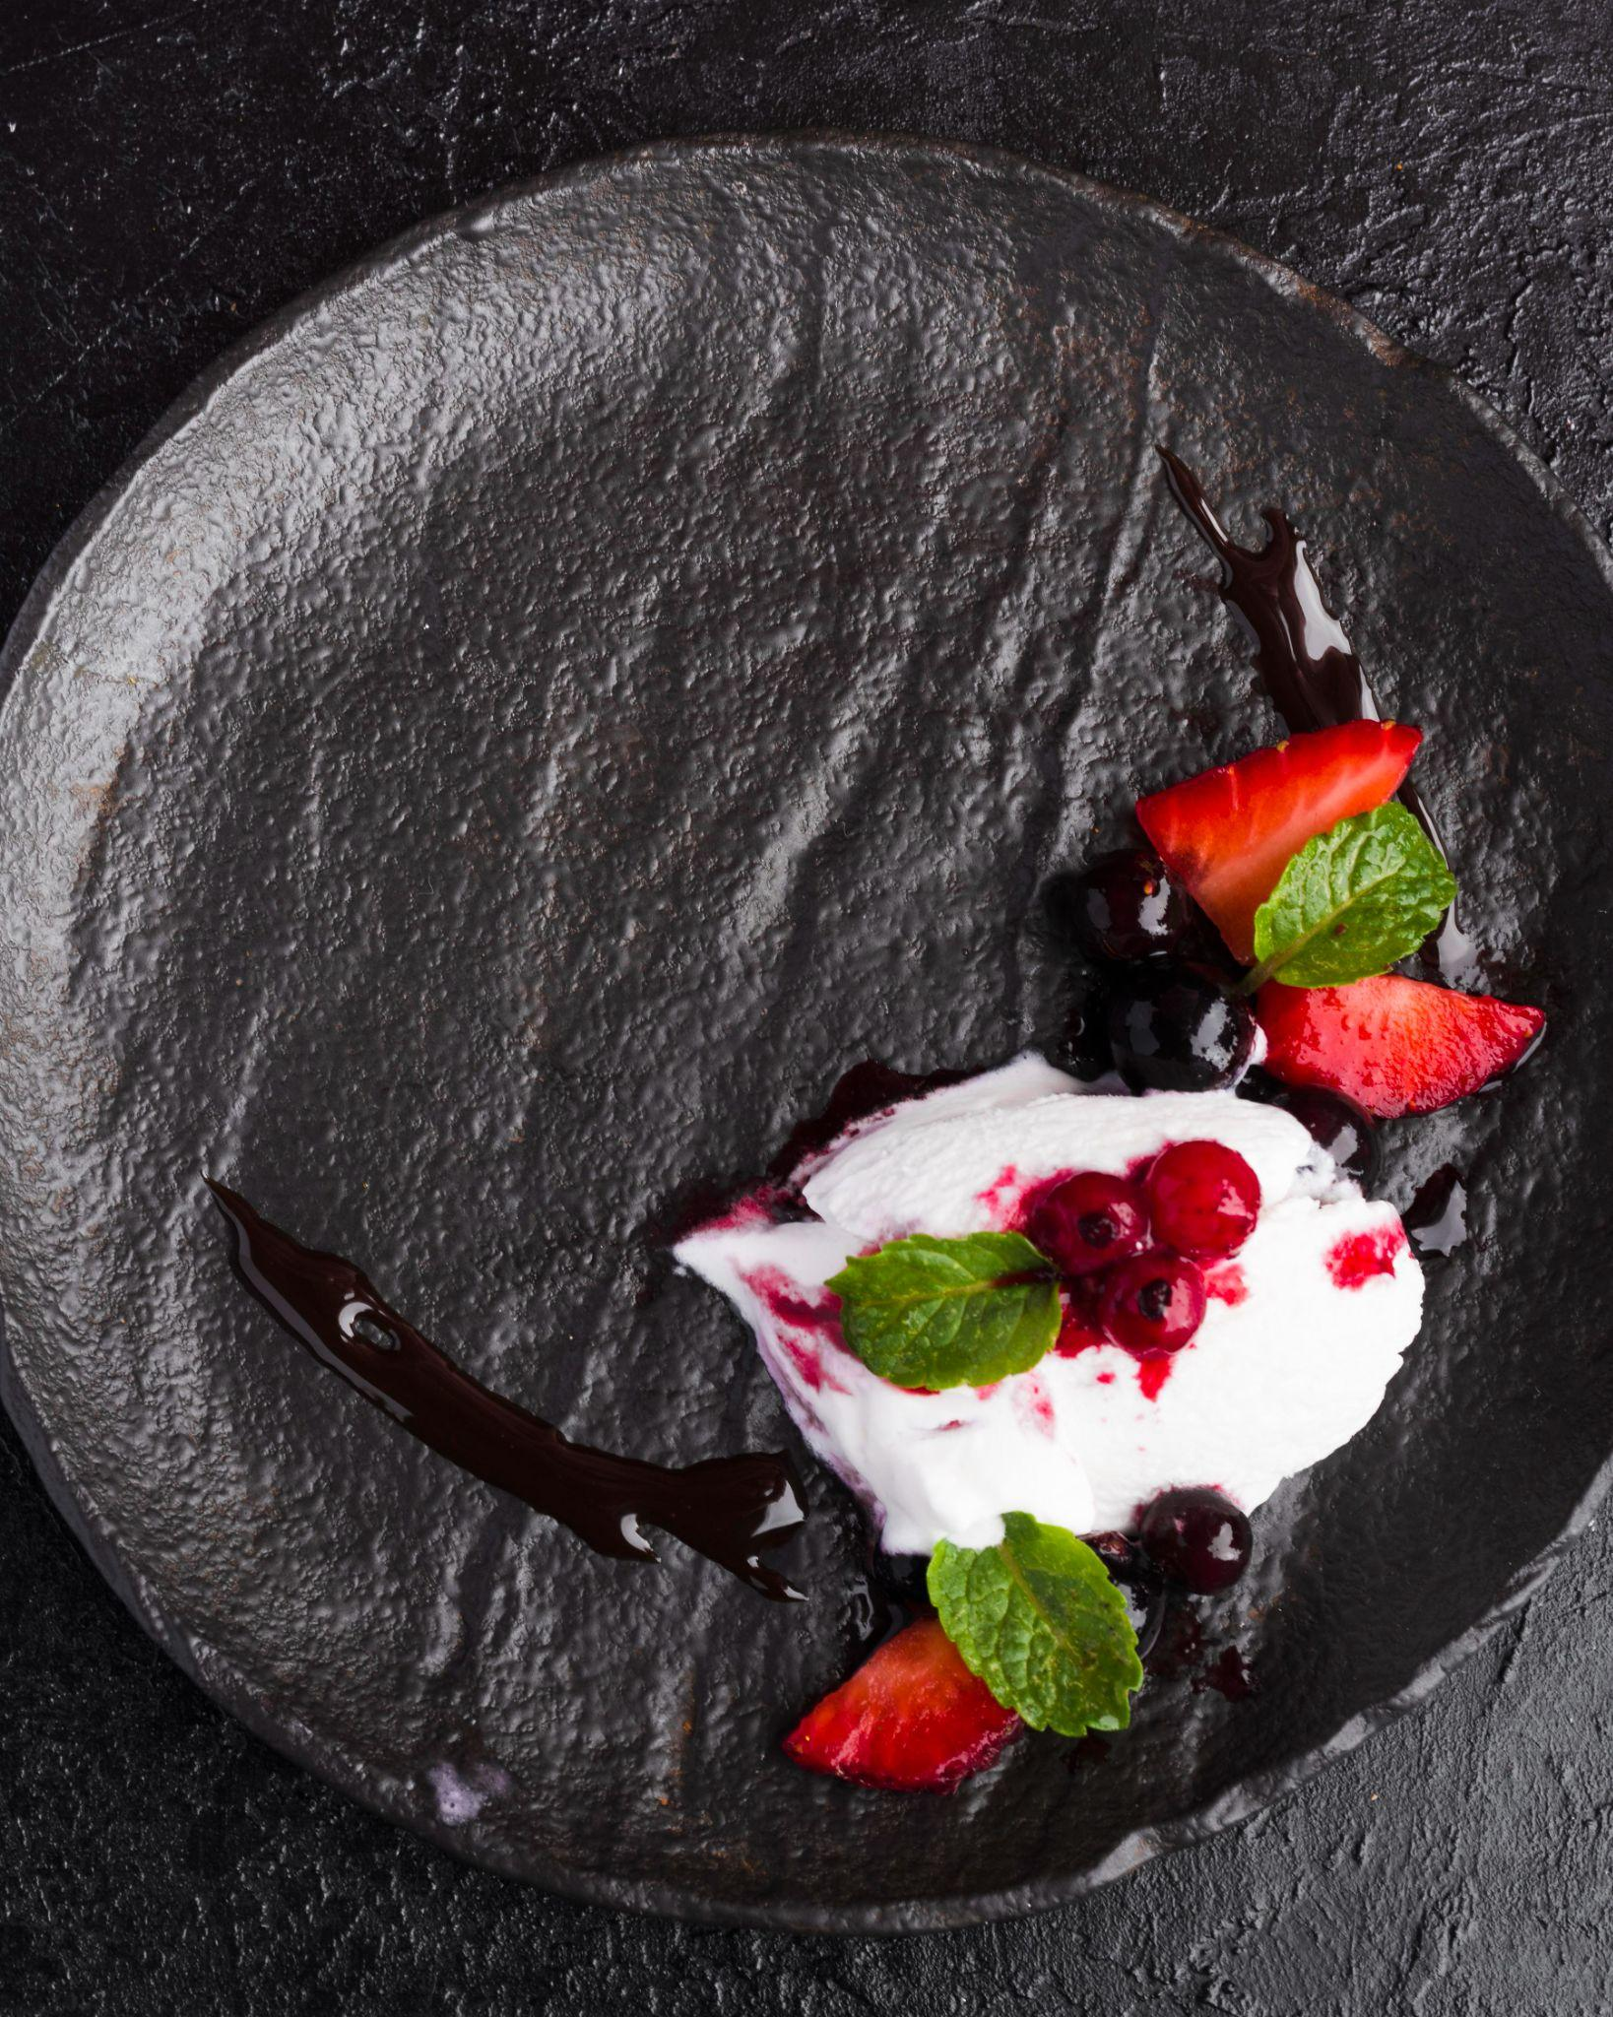
REACH OF ZOMATO INDIA
Let’s see which Indian state is leading in delivering food online via Zomato

Slide 4
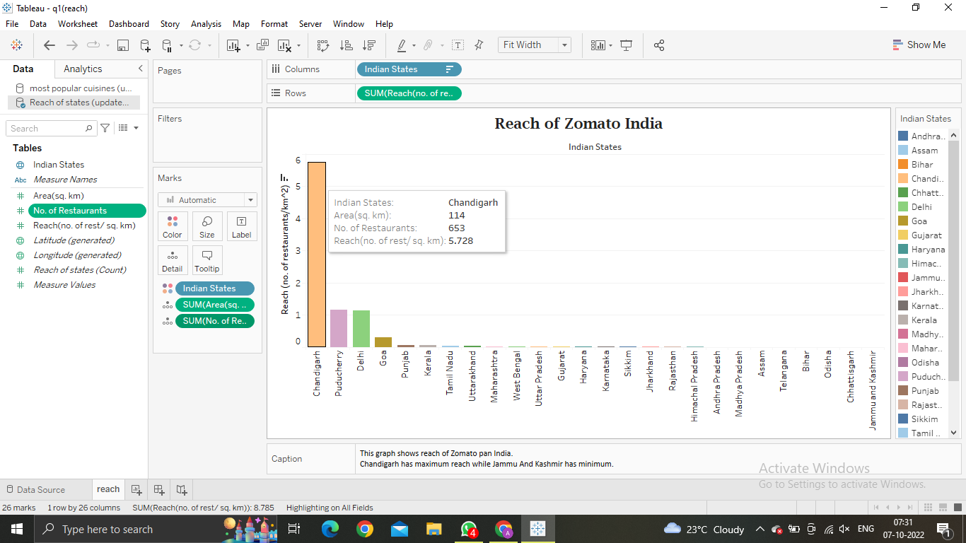

Slide 5
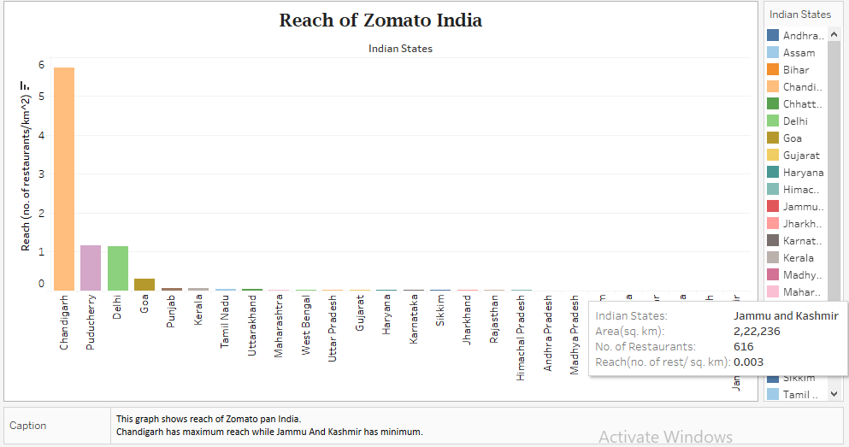

Slide 6
INSIGHTS
The graph makes it clear that Chandigarh has maximum reach.
Jammu And Kashmir has the minimum reach.
SUGGESTION
Online food delivery should be encouraged in Jammu And Kashmir so that people can have easy access to food anytime and anywhere.
More and more number of restaurants should collaborate with Zomato there, as it will be beneficial for both the restaurant, Zomato company and the local people living there.

Slide 7
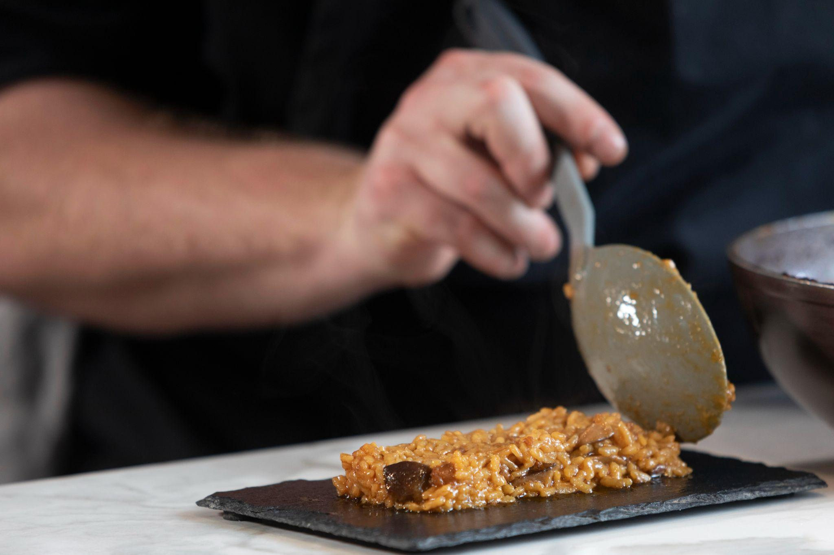
MOST POPULAR CUISINES ACROSS INDIAN STATES
Let’s find out what India is eating

Slide 8
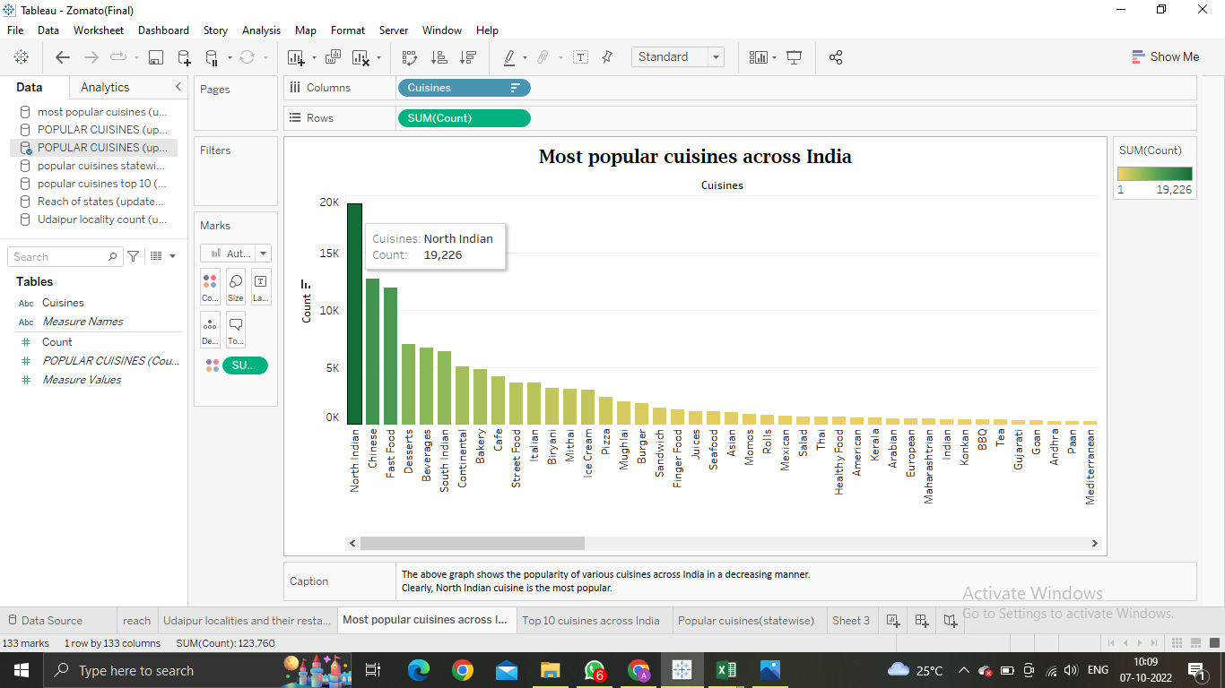

Slide 9
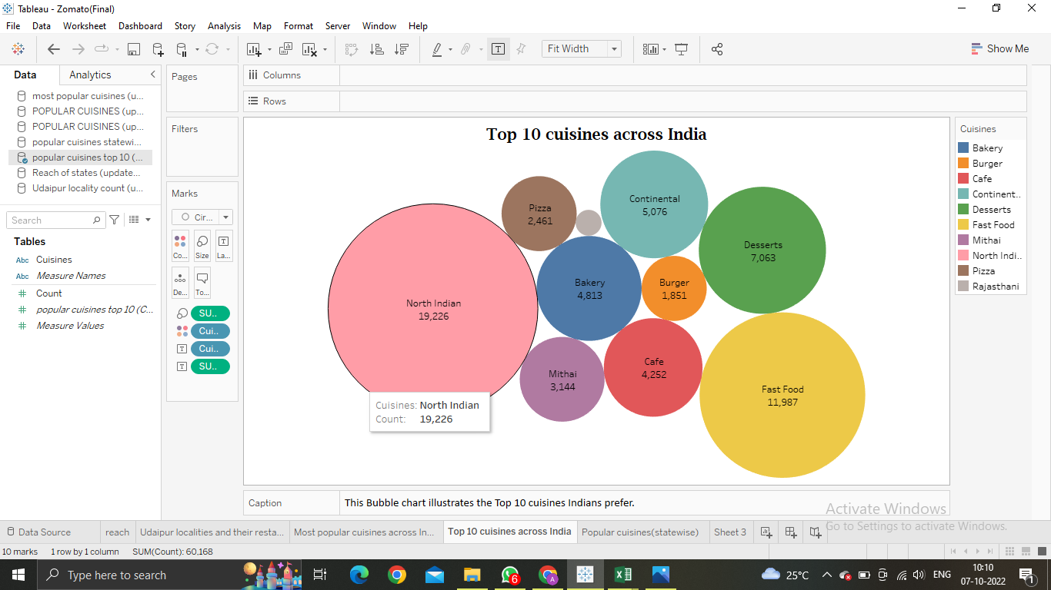

Slide 10
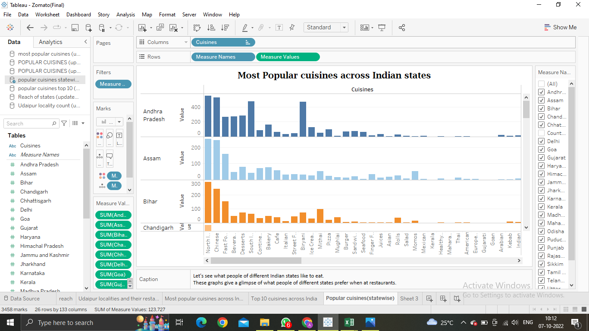

Slide 11
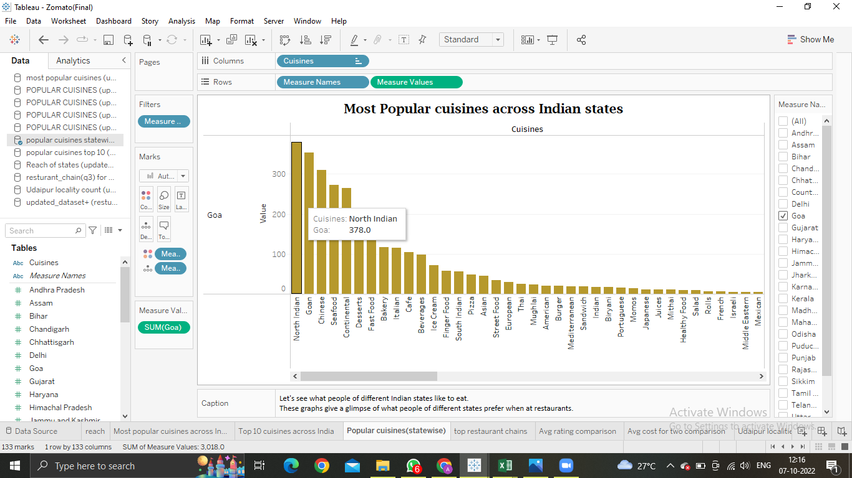

Slide 12
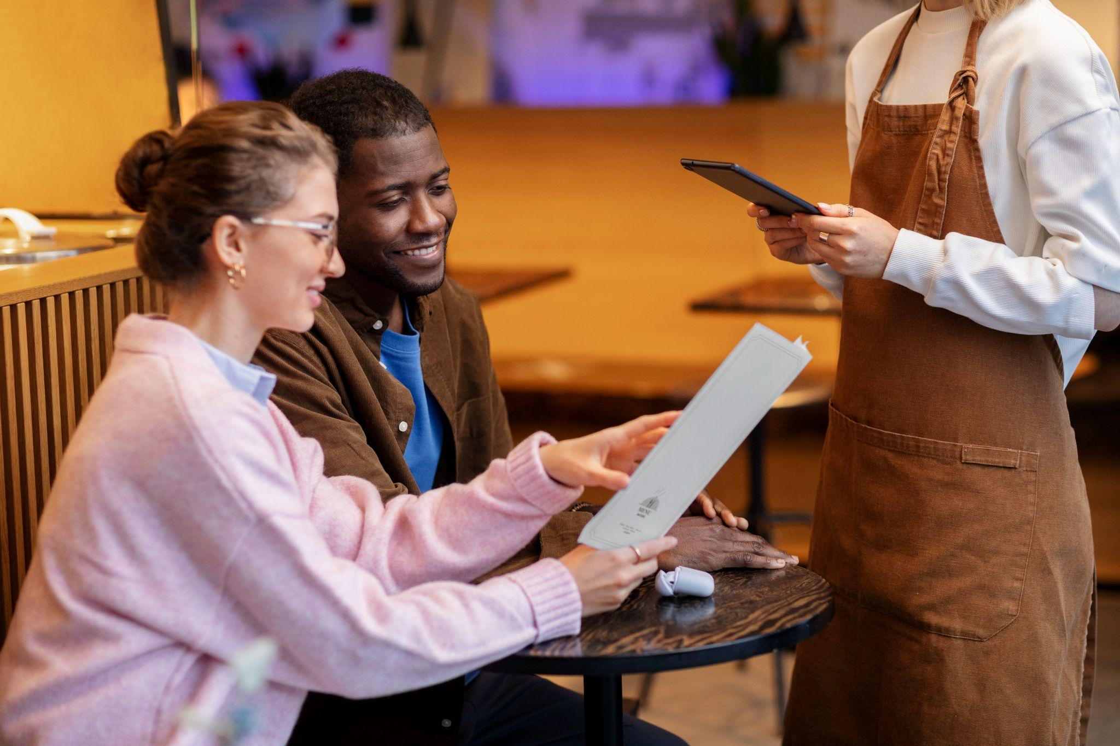
MOST POPULAR RESTAURANT CHAINS
Let’s see what India is eating

Slide 13
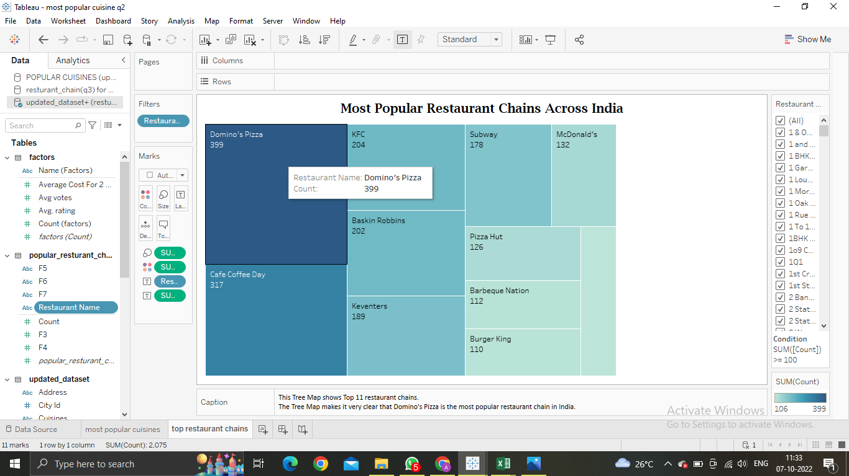
Which Restaurant is Preferred by Indians?

Slide 14
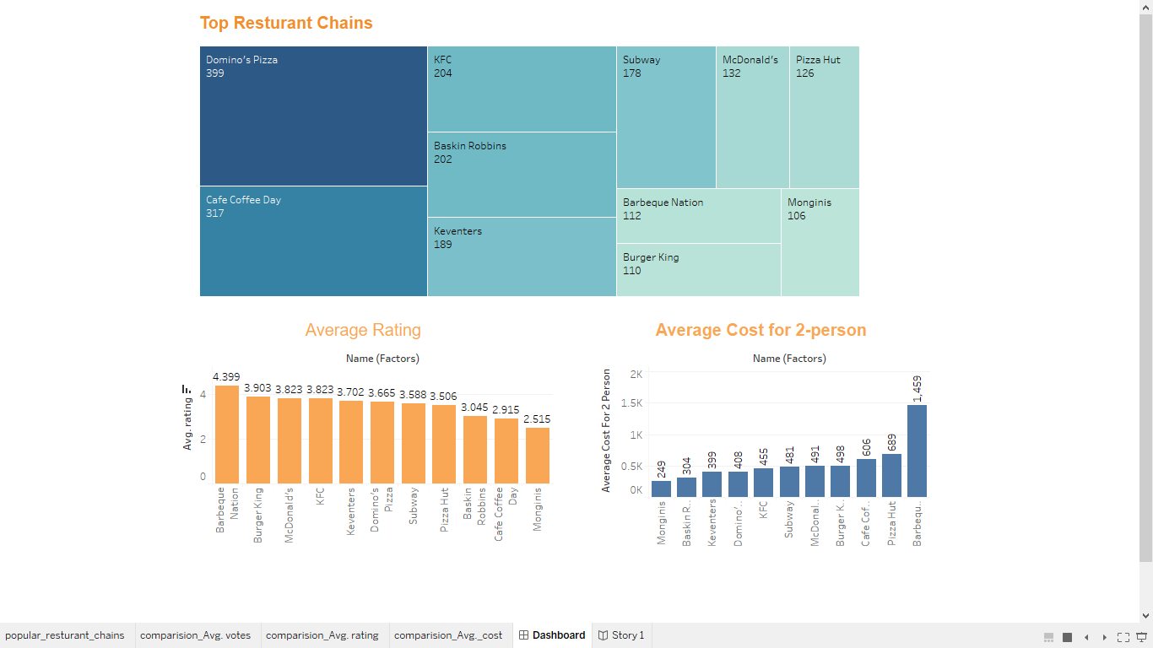
A Further Comparison…

Slide 15
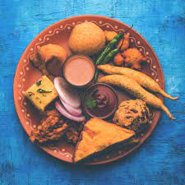
UDAIPUR
THE CITY OF LAKES AND PALACES

Slide 16
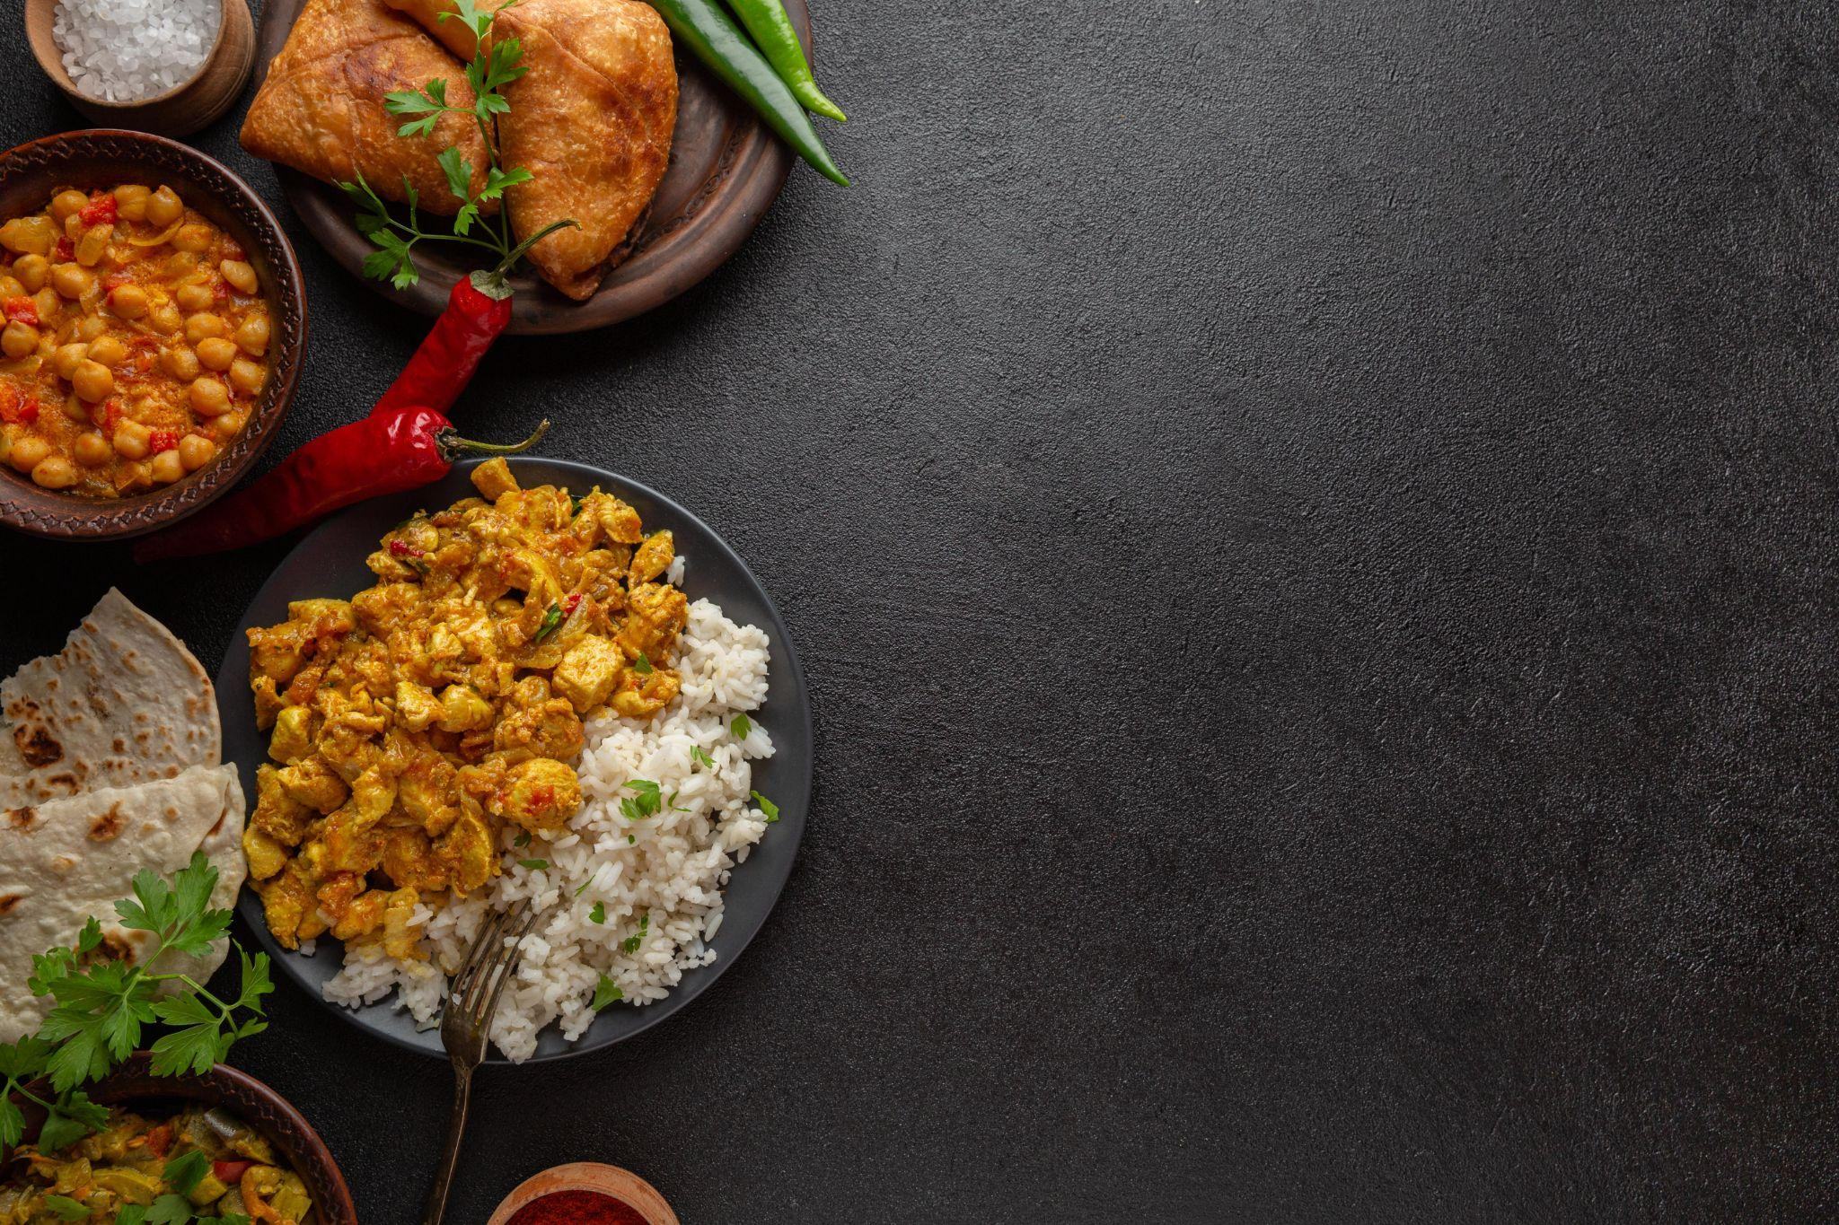
Where to open my Restaurant in Udaipur?!

Slide 17
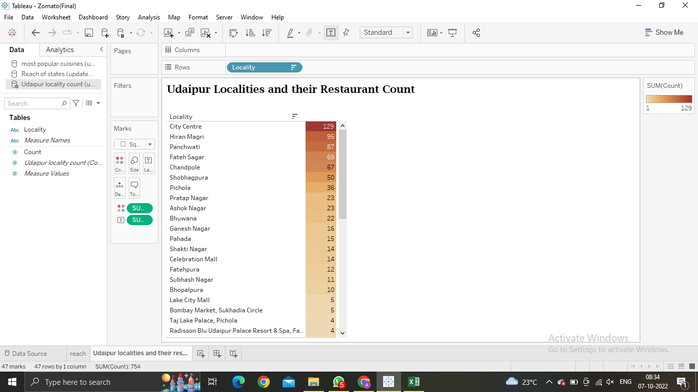
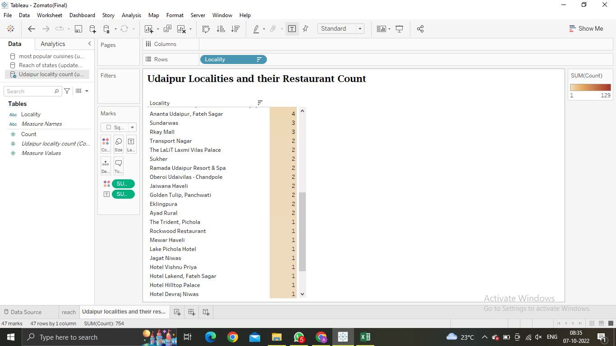
Let us first have a look at the distribution of count of restaurants across various localities of Udaipur

Slide 18
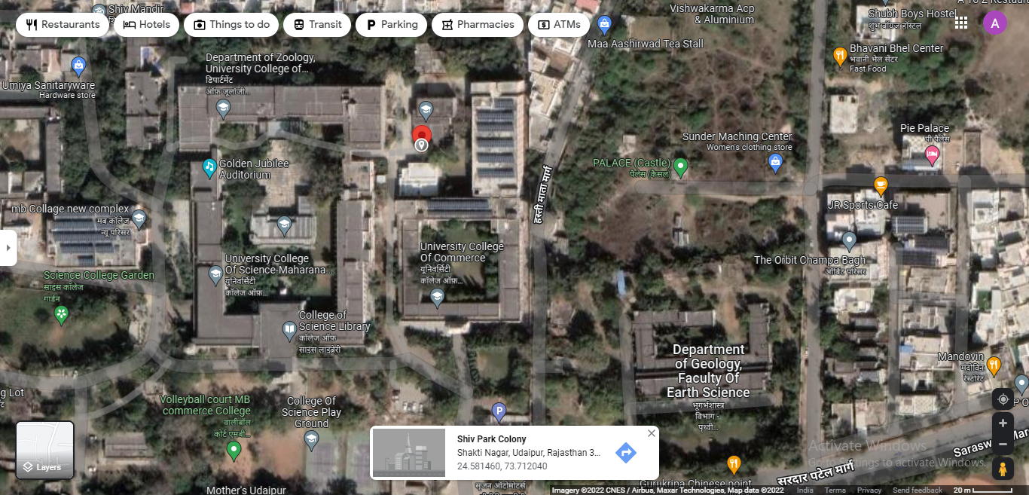
Shakti Nagar….the most preferable locality?

Slide 19
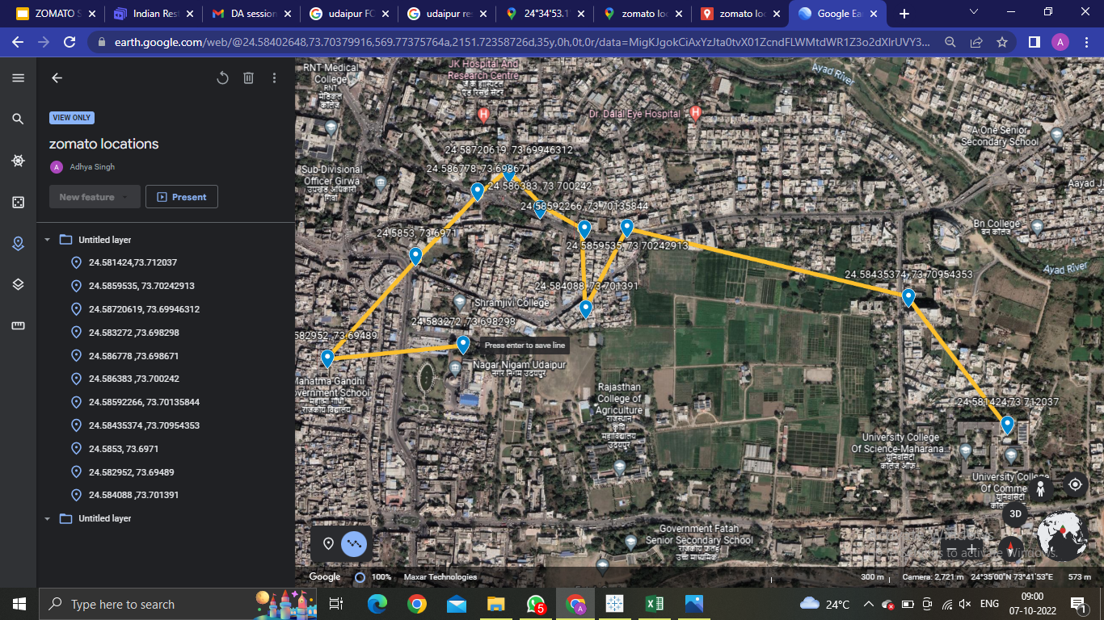
Do we have competition around?

Slide 20
WHY WE CHOSE SHAKTI NAGAR?
Less competition.
Our competitors are quite far away from us.
The chosen locality has various College departments around.
If the Menu, prices and rest parameters are designed strategically and as per a student’s need, our restaurant will have a high chance of becoming successful in really short time.

Slide 21
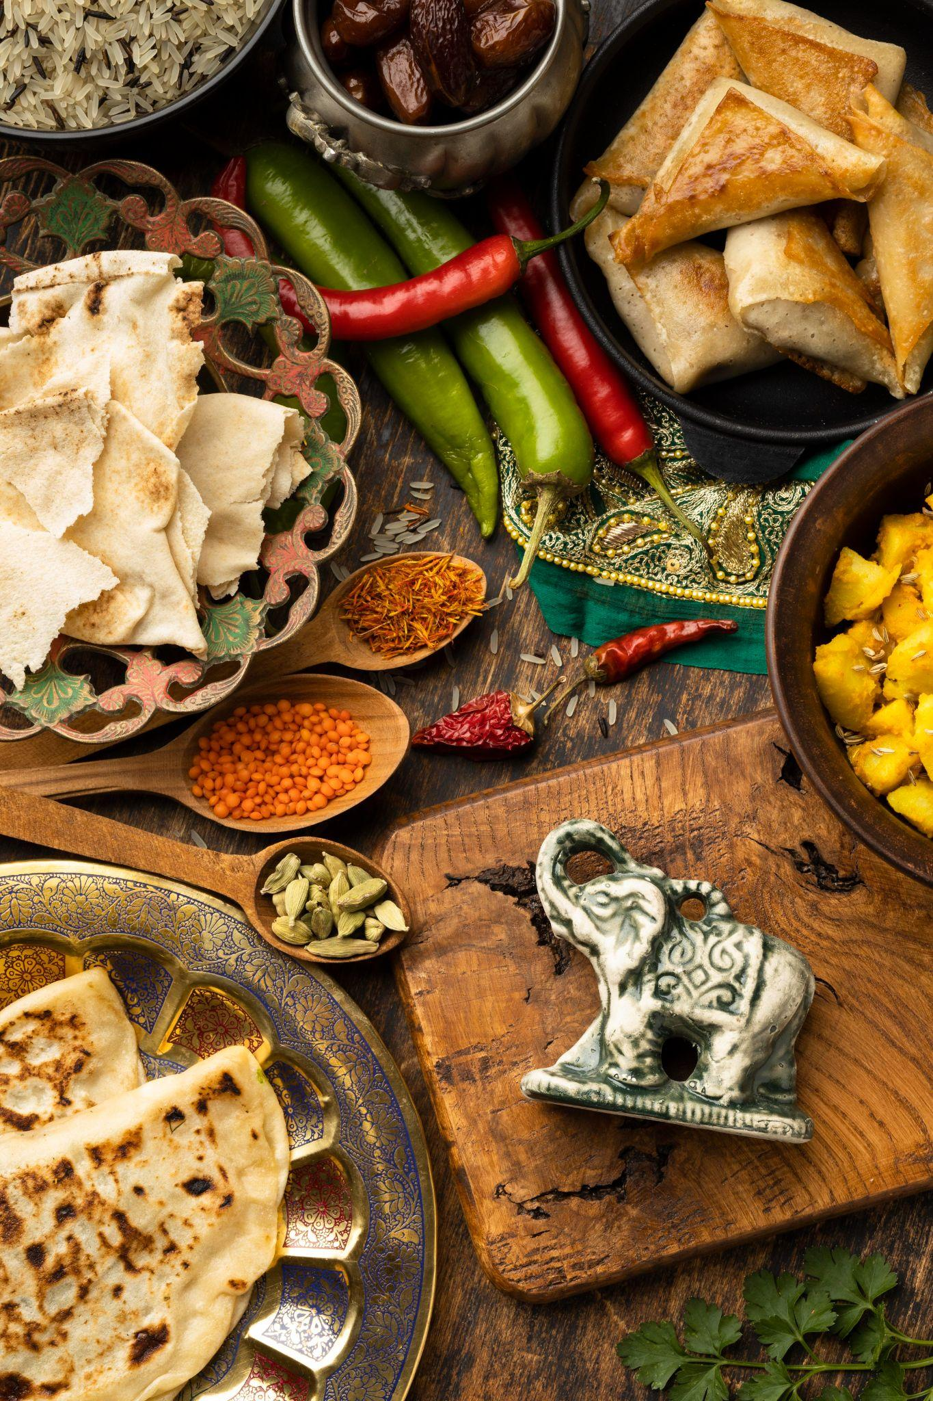
PARAMETERS OF OUR RESTAURANT
-EATOSS

Slide 22
Major Parameters For Our Restaurant
Establishment
Cuisine
Price Range
Cost for two persons
Casual Dining
North Indian, Chinese, Fast food and Rajasthani
@ Rs. 400
2 price ranges

Slide 23
Reasons For Given Parameters
Establishment | Count(Udaipur) | Count(Shakti Nagar)
Quick Bites | 179 | 4
Casual Dining | 183 | 2
Cafe | 99 | 1
Fine Dining | 44 | 0
Bakery | 44 | 2
Dessert Parlour | 49 | 0
Casual Dining is one of the most opened restaurants in Udaipur but is low in Shakti Nagar

Slide 24
Reasons For Given Parameters
Cuisines | Count
North Indian | 310
Rajasthani | 50
Fast Food | 143
Chinese | 151
Cafe | 98
Continental | 93
Bakery | 49
Italian | 48
Street Food | 63
Beverages | 53
In this table we can see Top 10 popular cuisines list

Slide 25
Reasons For Given Parameters
Price range | Count (Udaipur) | Count (Shakti Nagar)
1 | 478 | 10
2 | 161 | 3
3 | 56 | 1
4 | 59 | 0
Udaipur | Shakti Nagar
563.5119363 | 407.1428571
Shakti Nagar has less number of restaurant having two price ranges
In above table we can see the average cost for 2 persons

Slide 26
Proper Hygiene, good quality food
Affordable prices
Excellent management
Properly designed Menu
Offers on online orders
Convenient table booking through mobile Application
Online payment
Late Night Snacks
Highlights
Online delivery of Food, Takeaways
Flexible Timings ( 7a.m. - 12 p.m.)

Slide 27
THE EXACT LOCATION OF OUR RESTAURANT
Do visit :)

Slide 28
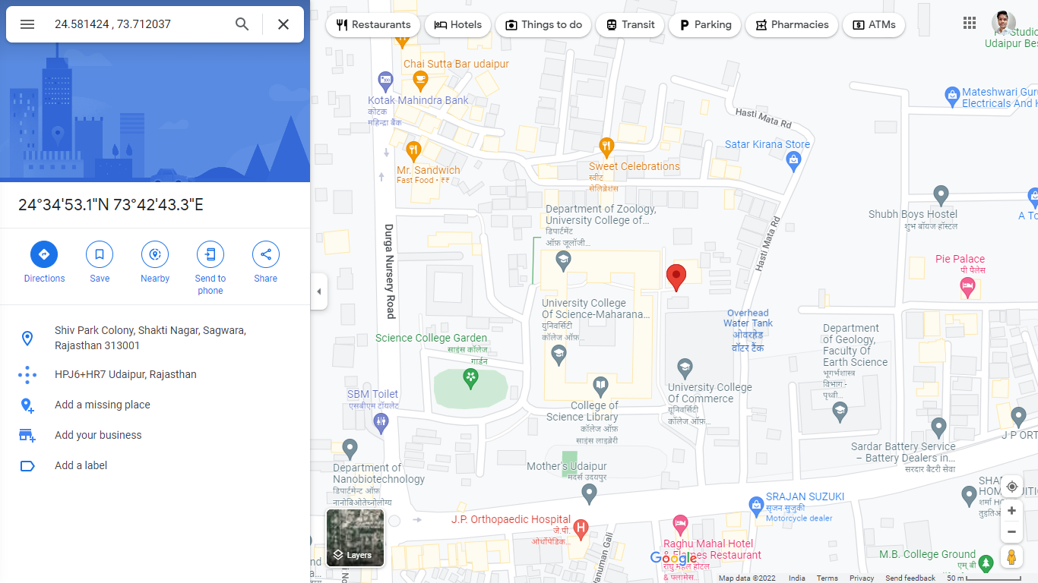
Location : ideal place for open a New Restaurant
(24.581424, 73.712037)

Slide 29
Explanation
Educational institutions
Nearby Hostels
30%
70%
Central point of connective road of many locality
No. of Casual Dining Restaurant in this area is quite low

Slide 30
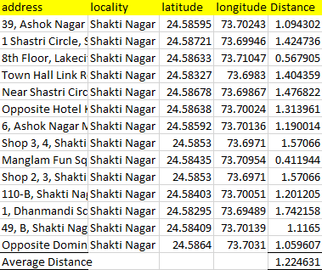
Distance of various restaurant

Slide 31
THANK YOU!

